Slide 1
Connecticut R1983 HES/HES-IE Process, Impact, and NTG Evaluation
Study Kick-off
Doug Bruchs and Fred Schaefer, Cadeo
Lisa Wilson-Wright and Nicole Rosenberg, NMR
Glenn Gavi and Shawn Bodmann, DNV GL
August 14th, 2020
Notes:
DOUG

Slide 2
Doug Bruchs
Overall Project Lead
Lead Team Members
Fred Schaefer
Impact Lead
Lisa Wilson-Wright
Process & NTG Lead
Glenn Gavi
Data Intake & Profiling Lead
Notes:
DOUG

Slide 3
Kickoff
Process Evaluation
Stakeholder IDIs
Participant Surveys
Program Material and Data Review
Impact Evaluation
Billing Analysis
Building Simulation
Engineering Algorithms
Realization Rate Analysis
NTG Analysis
Data Management and Customer Profiling
Data Preparation and Management
Customer Profiling
Benchmarking and Reporting
Task Overview
Notes:
DOUG

Slide 4
Process ✓
Evaluation Priorities
Determining effectiveness of the program overall and of recent program updates
Analyze historical participation trends
Provide prospective-focused recommendations
Process
Notes:
NICOLE/JOANNE

Slide 5
Process ✓
Impact ✓
Interviewees
Program staff IDIs (n=2)
CAA-oversight IDI (n=1)
Vendor IDIs (n=up to 40)
Research Topics
Program delivery
Drivers and barriers
Financing and incentives
Data collection
Add-on measure penetration
Customer experience
Quality assurance
Non-participant spillover
DOE Home Energy Score option
Health and safety barriers
Task 2a – Stakeholder IDIs
Notes:
NICOLE/JOANNE

Slide 6
Process ✓
Impact ✓
Sample
n=600 HES & n=600 HES-IE
Adequate sample sizes for NTG & persistence for key measures (n=40 to 67)
Research Questions
Awareness
Satisfaction and engagement
Drivers and barriers to participation
Adoption of add-on measures
Financing
Application experience
Wait periods
Incentives and co-pays
Vendor performance
Attitudes towards DOE Home Energy Score option
Measure installation rates and functionality
Net-to-gross (NTG) for HES
Possibly NEIs
Task 2b – Participant Web Surveys
Notes:
NICOLE/JOANNE

Slide 7
Process ✓
Impact ✓
Program materials
Quality
Clarity
Consistency
Comprehensiveness
Accuracy
Facilitation of financing
Accessibility to incentives
Integration of DOE Home Energy Score
Program data
Performance metrics
Quality
Consistency
Wait periods
Vendor performance
Add-on measure penetration
Task 2c – Material & Data Review
Notes:
NICOLE/JOANNE

Slide 8
Impact ✓
Evaluation Priorities
Robust gross and net savings
Measure-level results for utility and delivered fuels
Realization rates, including drill-down on deviations and, if necessary, recommendations for improvement
Compare process and results with Recurve’s efforts
Transparency and documentation
Impact
Notes:
DOUG

Slide 9
Impact ✓
Approach
Blend billing analysis, engineering algorithms, and building simulation to evaluate every measure
Provides measure-level savings for delivered fuels, various replacement scenarios, changes over time
Complementary to Recurve’s whole-home approach
Impact
Measure Group | Measure | HES |  | HES IE
 |  | Electric | Natural Gas | Electric | Natural Gas
DHW Conservation | Pipe insulation, showerhead, aerator, WH thermostat reset | Algorithm
Insulation | Weatherization (any insulation/air sealing) | Billing Analysis
 | Specific insulation types (wall, attic, basement & air sealing) | Engineering Adjusted Billing Analysis*
Duct Sealing | Sealing and insulating forced air ducts | Algorithm
Heating | System replacement | Engr Adj BA* | Billing Analysis | Engr Adj BA* | Billing Analysis
 | Heat pump installation | Building Simulation
 | Cleaning/tuning/repairs, circulator and fan upgrades | Algorithm
Lighting | Whole-home savings | Billing Analysis |  | Billing Analysis
 | Specific lighting types (GP, reflectors, fixtures | Engr Adj BA* |  | Engr Adj BA*
Refrigeration | Replacement | Algorithm |  | Algorithm
* Engineering Adjusted Billing Analysis = high level billing analysis with algorithm or building simulation to disaggregate savings for individual measures
Notes:
DOUG

Slide 10
Impact ✓
Recurve
Aware that Recurve is supporting HES/HES-IE implementation, includes estimating savings for 2017-2018 (Both efforts need at least a year of post-data to weather-normalize and provide ex post savings)
Designed a multi-faceted, best practice-based impact approach that complements, leverages, and aligns with Recurve’s efforts
Complementary. Measure-level and delivered fuel savings using multiple approaches
Leverage. Use data that UI and Eversource provided to Recurve to ensure consistency and avoid redundancy
Alignment. Side-by-side comparison with Recurve’s processes and results
Impact
Notes:
DOUG

Slide 11
Impact ✓
Billing Analysis
Preferred impact approach
Ideal for whole-home or larger savers (e.g., lighting and Wx)
Monthly post program regression (PPR) models
Treatment group of 2017/18* participants
Control group of “future” (2019*) participants using matched control group (MCG) method*
*Able to shift to include 2019 in treatment and Q1 2020 in control if data are available/participation levels sufficient; Covid-19 also a factor (potentially limits extrapolation)
Control for cross-program participation, including non-utilities measures (for HES-IE)
Integrate detailed survey findings for subset of analyzed participants; allows for additional specifications
Task 3a – Billing Analysis
Notes:
FRED

Slide 12
Impact ✓
Building Simulation
Works better than billing analysis for certain measures (e.g., frequently bundled measures like air sealing, attic, wall, and basement/floor insulation)
Use NREL’s BEopt modeling software
Use a series of models reflecting prevalent HES/HES-IE home types and heating/cooling combinations
Calibrated for both programs using billing analysis
Provide BEopt models, as well as supporting analytical workbooks as deliverables, aids program planning
Task 3b – Building Simulation
Notes:
FRED

Slide 13
Impact ✓
Engineering Algorithms
Works best for smaller savings measures that are not subject to interactive effects (e.g., DHW measure like showerheads and aerators)
Used to calculate delivered fuel savings (through engineering adjustments to billing analysis results)
Inputs and values from program data
Savings algorithm from PSD
Comparison of PSD and evaluation inputs, including explanation of any differences
Provide supporting analytical workbooks as deliverables, which can also support program planning
Task 3c – Engineering Algorithms
Notes:
FRED

Slide 14
Impact ✓
Process ✓
Additional tasks that build off impact analysis and participant survey for greater insight
Compare participants’ actual pre/post consumption to their modeled consumption
Review implementer models
Interviews with modeling team
Analyze disparity by…
Dwelling type
Building size
Climate zone
Insulation type
Outputs
Identification of realization rates drivers for weatherization
Recommendations for model, process, or PSD changes
Task 3d – Realization Rates
Notes:
FRED

Slide 15
Impact ✓
HES only (assume NTG = 1 for HES-IE)
Participant surveys
Free-ridership (FR)
Participant spillover (PSO)
Photo-app follow up with substantial PSO
Oversample for key measures
Leverage prior study questions and algorithms
Conduct sensitivity analyses
Stakeholder IDIs
Non-participant spillover (NPSO)
Analyze PSO vs. NPSO overlap
Task 3e – Net-to-Gross Estimates
Notes:
FRED

Slide 16
Process ✓
Impact ✓
Profiling ✓
Purpose
Provide insights into reasons for non-participation and program equity
Determine geographic variations in participation; especially related to demographics
Produce solid foundation for targeted outreach, surveys, etc.
Task 4b – Customer Profiling
Notes:
SHAWN

Slide 17
Process ✓
Impact ✓
Profiling ✓
Block group-level analyses
Geocode tracking & billing data to Census block groups
Layer on demographics from ACS and HUD
Compare to individual level analysis using Eversource Experian data
Calculate participation rates
Identify characteristics of high- and low-participating areas (e.g. income, ESL, housing age)
Identify higher- and lower-than-expected participating areas
Task 4b – Customer Profiling
Notes:
SHAWN

Slide 18
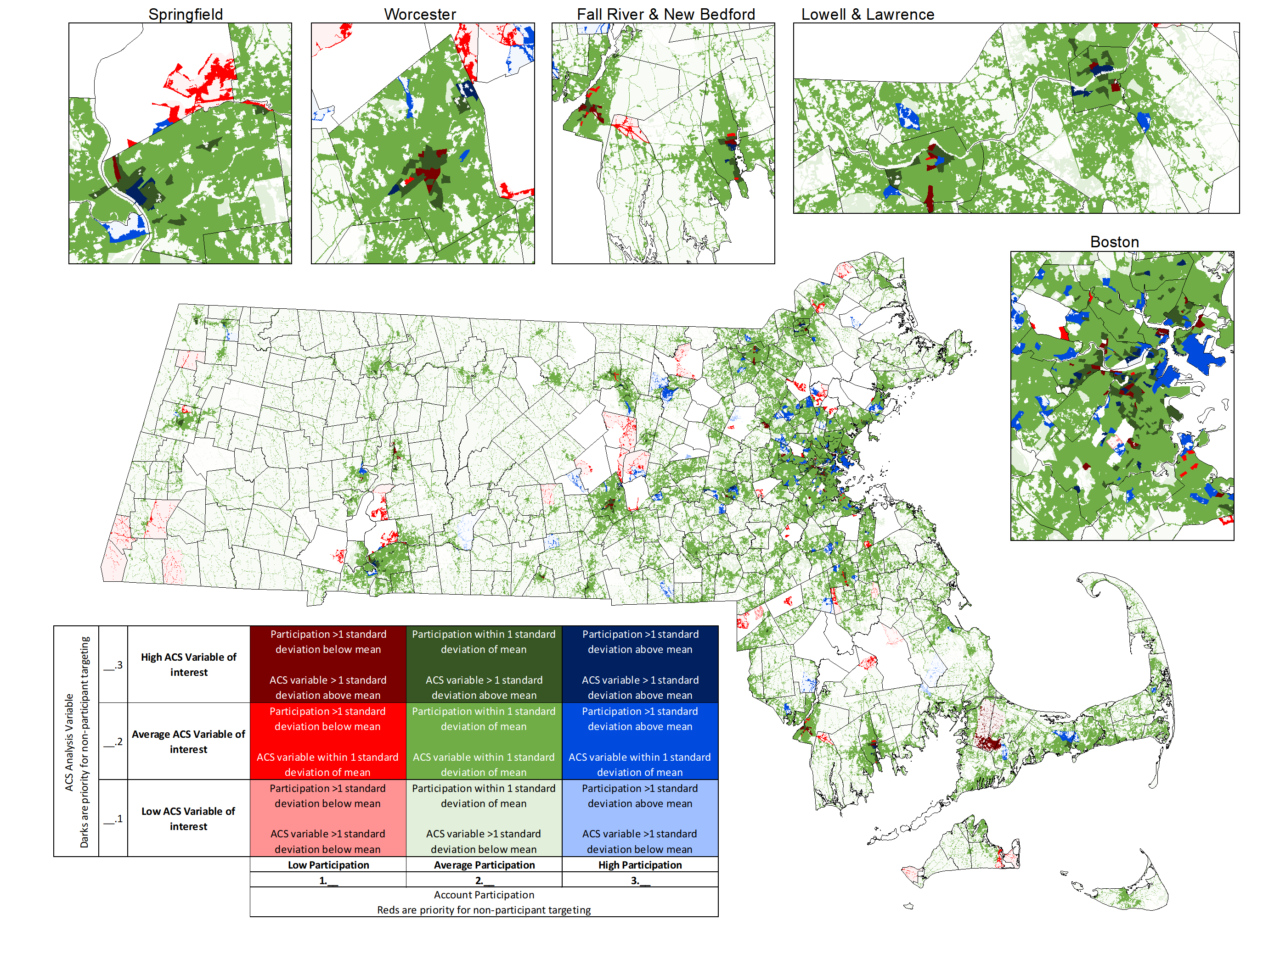
Profiling ✓
Key Outputs
Identify and rank characteristics associated low/high participation (e.g. in MA, renter status rose to top)
Geographic targeting
Customer Profiling
Notes:
SHAWN

Slide 19
Process ✓
Impact ✓
Profiling ✓
Sending combined data request shortly
Covers multiple projects:
R1983 Survey & IDI samples
R1983 Impact tasks
R2029 Weatherization Assessment / Update
X1942 NEIs
Task 4a – Data Prep & Management
Notes:
NICOLE

Slide 20
Addressing COVID-19 Complexities
Will strictly adhere to Company’s COVID-19 related customer contact protocols
Acknowledge COVID-19 during surveys/interviews and explicitly focus respondents on the relevant evaluation/program period
Include COVID-19 related questions in vendor IDIs
Attempt to exclude COVID-19 period (March 2020-?!) in billing analysis and customer profiling efforts
Discuss impact (if relevant) in reporting
Consideration for all forward looking recommendations
COVID-19
Notes:
NICOLE

Slide 21
Process ✓
Impact ✓
Profiling ✓
Benchmarking
Past HES/HES-IE studies in CT
Track issues, trends, and progress in CT
Comparable programs in other nearby jurisdictions
Target schedule aligns with PSD/Planning revisions
March 2021 - Preliminary findings
May 2021 - Draft report to EA team
June 2021 - Draft report for public review
July/August 2021 - Final presentation/report
Task 5 – Benchmarking and Reporting
Notes:
DOUG

Slide 22
Process Evaluation
Effectiveness of program and program changes
Recommended improvements in design, delivery, and outreach
Impact Evaluation
Gross and net measure-level savings for all fuel types
Recommendations for improving realization rates
Retrospective NTG ratios
Recommended prospective NTG ratios for same measures
Data Management and Customer Profiling
Participation rates and geographic / demographic analysis of participants / non-participants
Equity insights (rent/own, non-English, income level)
Identify and rank characteristics and block group levels associated with high / low participation
Recommend specific geographic areas to target for additional research or outreach
Project Outcomes
Notes:
DOUG

Slide 23
 |  | Tasks
Topic |  | Stakeholder Interviews | Participant Surveys | Program Material & Data Review | Billing & Realization Rate Analysis | Building Simulation & Engineering Algorithms | Customer Profiling | Benchmarking
Process Evaluation | Program delivery and performance | ✓ | ✓ | ✓ |  |  |  | ✓
 | Data quality and data management | ✓ |  | ✓
 | Drivers for impact results | ✓ | ✓ | ✓ | ✓ |  |  | ✓
Impact Evaluation | Retention/Persistence |  | ✓ |  |  |  |  | ✓
 | Gross and net savings |  |  | ✓ | ✓ | ✓ |  | ✓
 | Net-to-gross | ✓ | ✓ |  |  |  |  | ✓
 | Realization rates drivers | ✓ | ✓ | ✓ | ✓ | ✓ |  | ✓
Potential & Long-term Strategies | Customer profiling |  |  | ✓ |  |  | ✓ | ✓
 | Targeting via census data |  |  | ✓ |  |  | ✓
Data Collection / Research Links
Notes:
DOUG

Slide 24
Any other questions?
Q & A

Slide 25
Task | Budget
Task 1 - Workplan & Kickoff | $35,00
Task 2 - Process Evaluation | $205,000
Task 3 - Impact Analysis | $225,000
Task 4 - Data Management & Profiling | $225,000
Task 5 - Benchmarking & Reporting | $110,000
Total | $800,000
Budget
Notes:
DOUG

Slide 26
$${\text{ADC}}_{\text{ct}}\text{=}{\text{b}}_{\text{1}}{\text{Treatment}}_{\text{c}}\text{+}{\text{b}}_{\text{2}}{\text{LagADC}}_{\text{ct}}\text{+}\sum_{\text{month} \text{i}}{{\text{b}}_{\text{3}\text{i}}{\text{Month}}_{\text{it}}}\text{+}$$
$$\sum_{\text{month} \text{i}}{{\text{b}}_{\text{4}\text{i}}{\text{Month}}_{\text{it}}\text{∗}{\text{LagADC}}_{\text{ci}}}\text{+}{{\text{b}}_{\text{5}}{\text{NonProg}}_{\text{c}}\text{ + }\text{e}}_{\text{ct}}$$
ADC_{ct} = Average, daily energy consumption for customer c at calendar month t
Treatment_{c} = 1 if customer c is in treatment group, 0 if customer c is in control group.
LagADC_{ct} = Average daily consumption from customer c during calendar month t of the pre-program period
Month_{it} = 1 when index i = calendar month t, 0 otherwise. We include this series of 12 terms to capture month-specific effects in our analysis.
NonProg_{c} = 1 if customer c received a non-program energy-efficiency or health and safety-related improvement
e_{ct} = The error term from the regression model.
Appendix: Billing Analysis PPR Model

